Slide 1
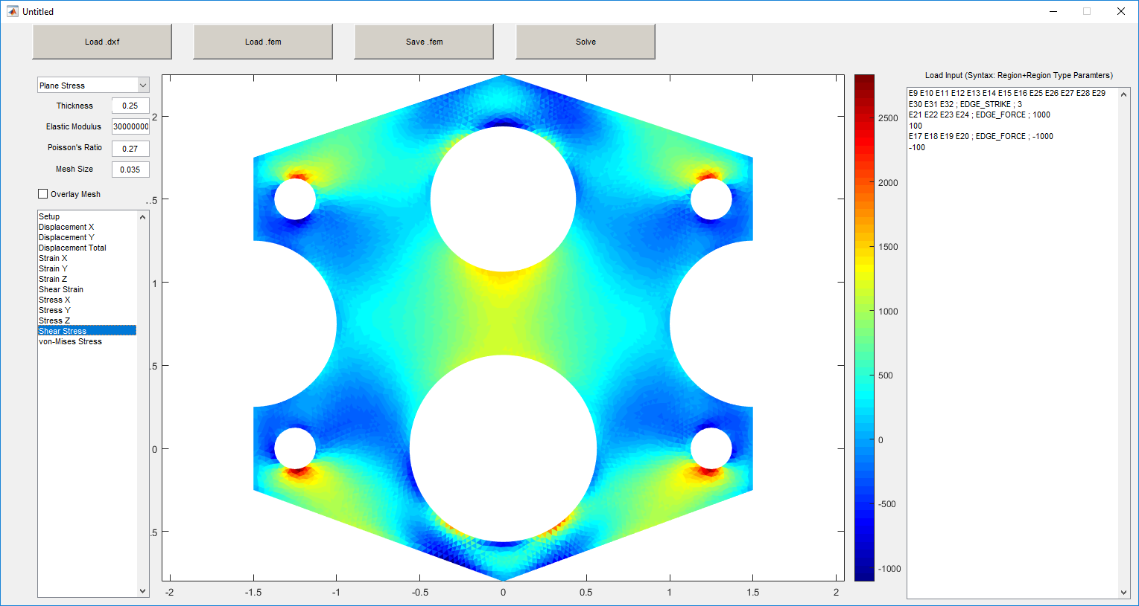
FE Solver
ME522 Spring 2017
Thaddeus Hughes, Dan Engstrom

Slide 2
Capabilities
Plane stress / plane strain
Point loads, edge loads, pressures, torques
Constraining edges or points
Outputs : x-, y-, and total displacement, x-, y-, shear and von Mises stress, x-, y-, and shear strain
Mesh refinement based on general mesh size
Linear materials: can modify modulus of elasticity, Poisson’s ratio, thickness
Penalty method for applied displacements (stability issues)

Slide 3
DXFs, Meshing, and Stiffness
Lines, Circles, and Arcs parsed from .dxf files
“Decomposed Geometry” created
MATLAB’s initmesh from PDE toolbox is used to create mesh with one-parameter size control
Tolerance stackup; PDE toolbox thinks some arcs aren’t connected
Creates p, e, and t matrices
refinemesh may be able to refine mesh for specific triangles afterwards (not implemented)
jigglemesh can help make better meshes (not implemented)
Gaussian Quadrature is used to create stiffness matrices (no symbolic toolbox whatsoever in entire project)

Slide 4
Loading
Loads input via text box in the form of E1 E2 P1 P2 ; LOAD_TYPE ; ARGUMENT1 ARGUMENT2
Point forces
Find applicable point and apply load to it in a df vector
Edge forces
Find applicable element edges and compute total length of them
Divide desired load by total length calculated
Distribute load to elements comprising edge in a df vector, scaling by edge length
Torques
Find applicable element edges
Determine centroid of edges
Find moment of inertia of edges
Divide torque by moment of inertia
Distribute load to elements, scaling by edge length and distance from centroid and placing load perpendicular to effective lever arm
Pressures
Find applicable element edges
Iterate through all elements, apply force normal to element face (half to one node, half to other node) with magnitude of Pressure*SideLength*Thickness
Add df vector to f vector (initially zeros)

Slide 5
Constraints
Constraints input via text box in same fashion
Point/edge “strikes”
Elimination method; Find applicable point(s) and add row/column numbers to “strikes” vector
Point/edge penalty
Penalty method; find applicable point(s)
Add max(max(abs(K)))*10^6 to each
Add dK matrix to K
Remove rows and columns of “strikes” vector

Slide 6
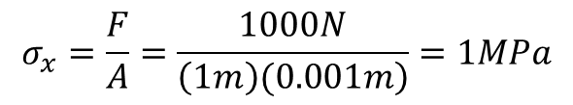
Patch test 1, element in tension
1m
0.001m
Stress in x-direction
$$σ_{x}=\frac{F}{A}=\frac{1000N}{\left.\left(1m\right)(0.001m\right)}=1MPa$$
1m
1000 N

Slide 7
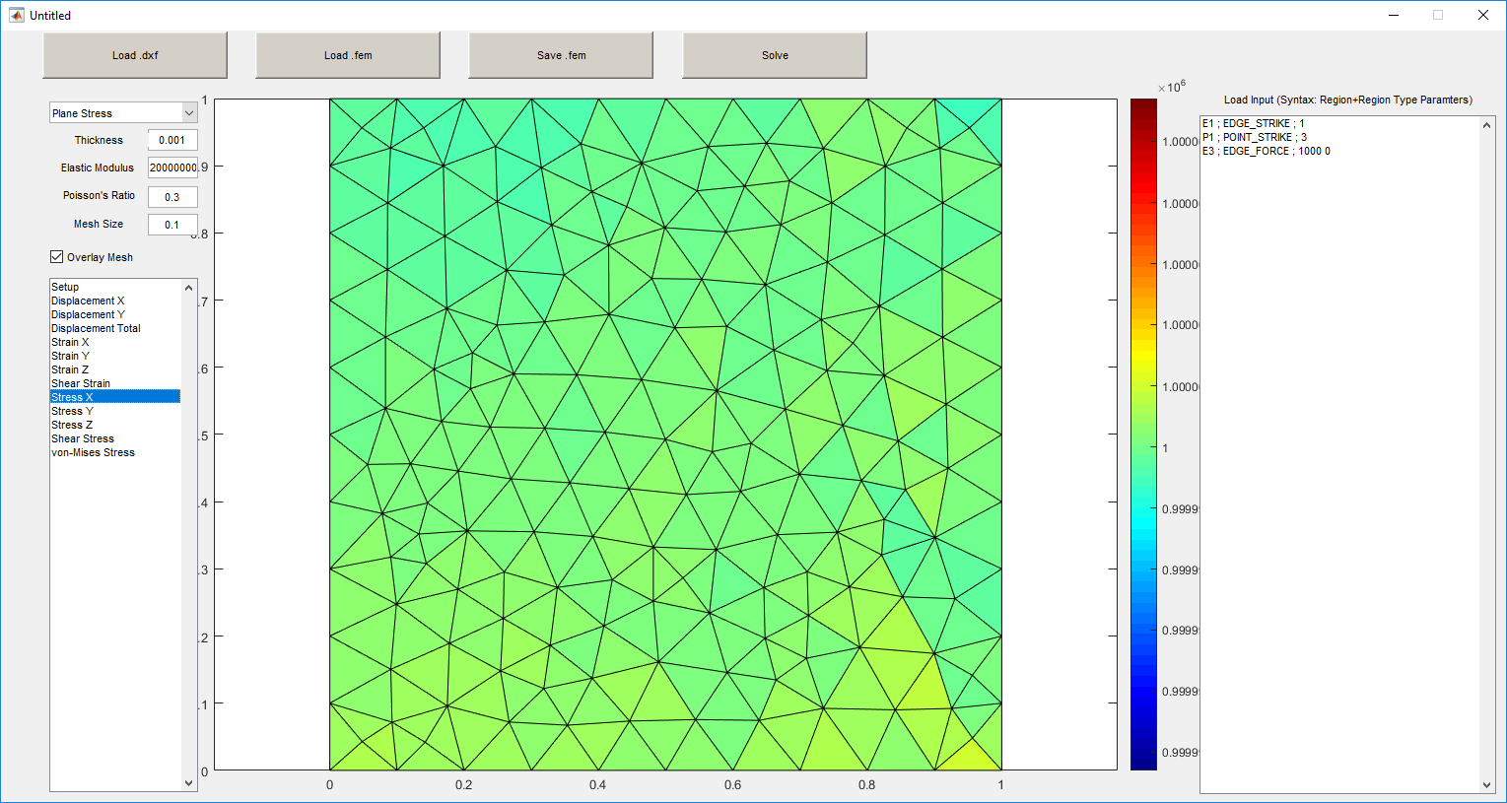
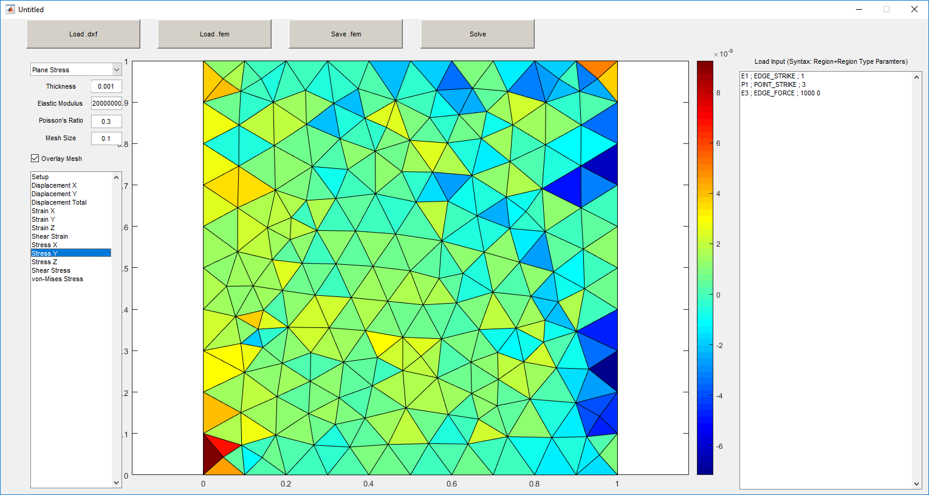
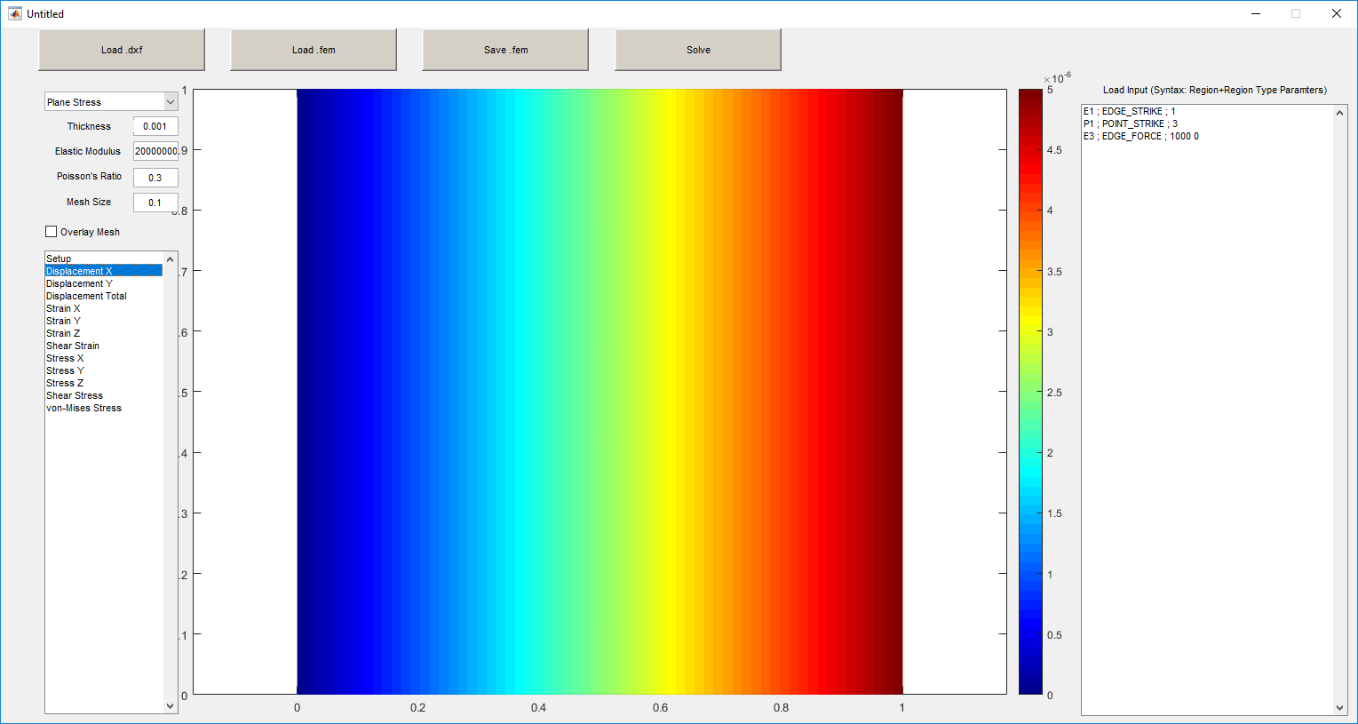
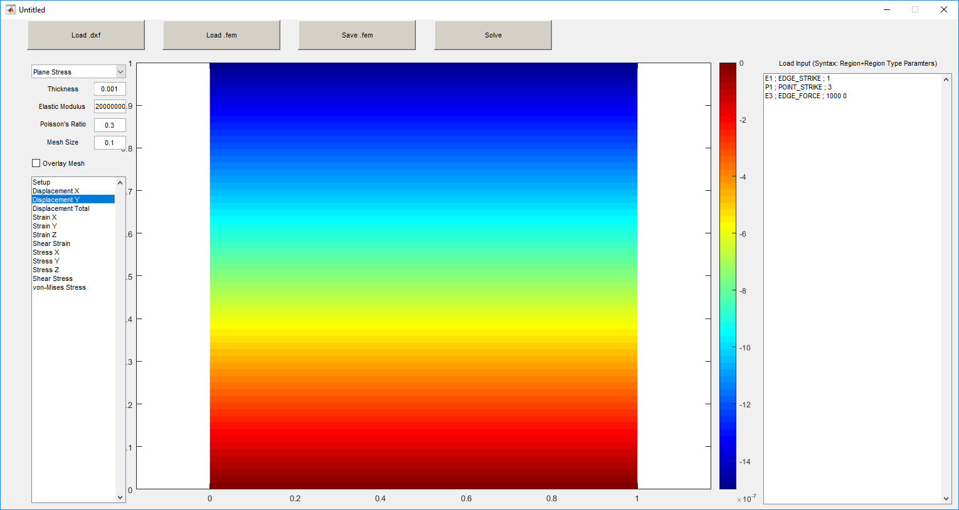

Slide 8
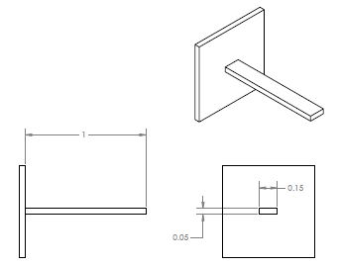
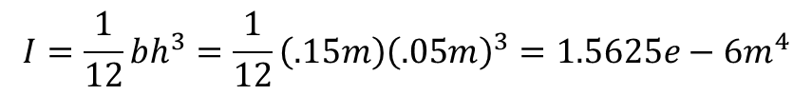
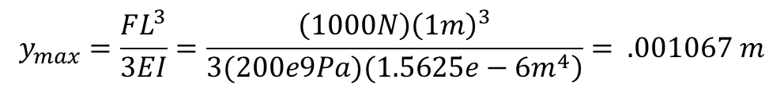
Patch test 2, cantilever beam, concentrated load
Euler-Bernoulli Beam Theory
$$I=\frac{1}{12}bh^{3}=\frac{1}{12}\left(.15m\right){\left(.05m\right)}^{3}=1.5625e−6m^{4}$$
1000 N
$$y_{max}=\frac{FL^{3}}{3EI}=\frac{\left(1000N\right){\left(1m\right)}^{3}}{\left.3(200e9Pa)(1.5625e−6m^{4}\right)}= .001067 m$$
Analytic solution taken from: Norton Machine Design: An Integrated Approach (3rd Edition)

Slide 9
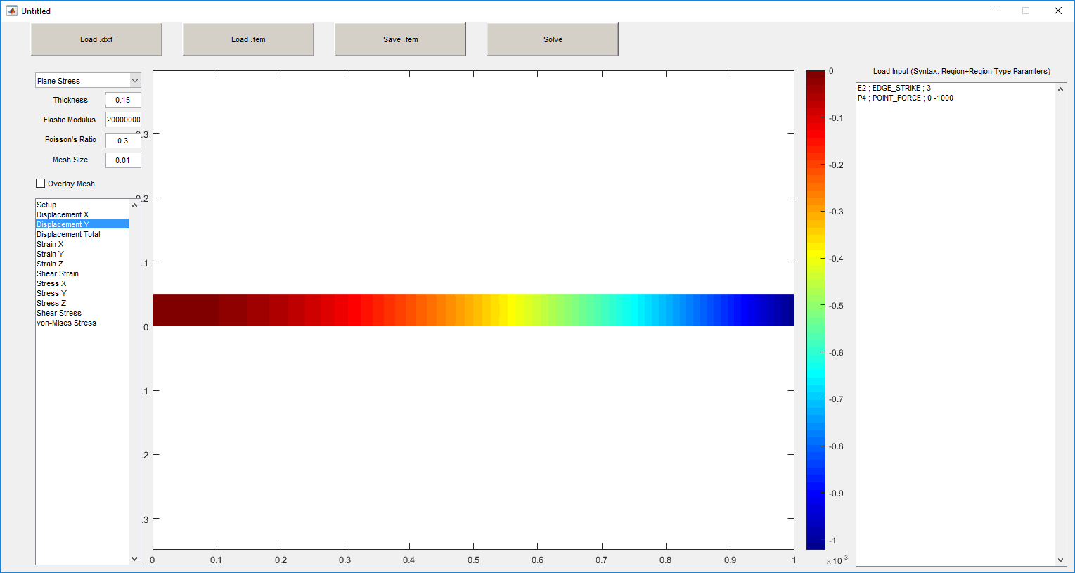
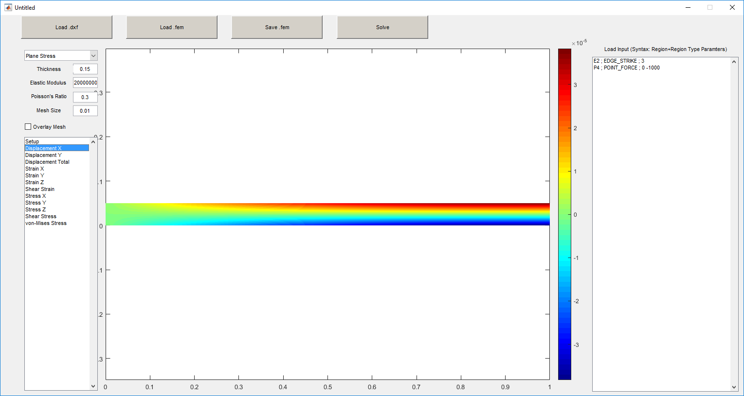
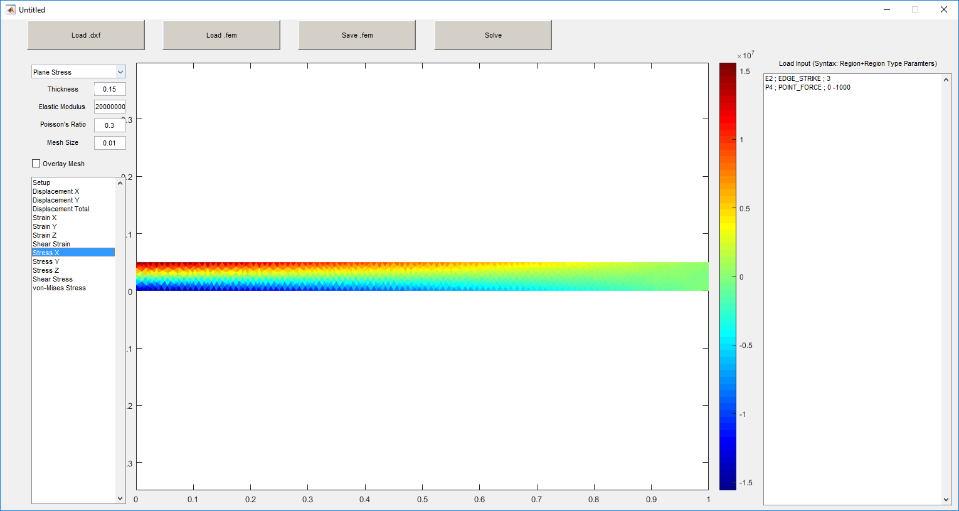
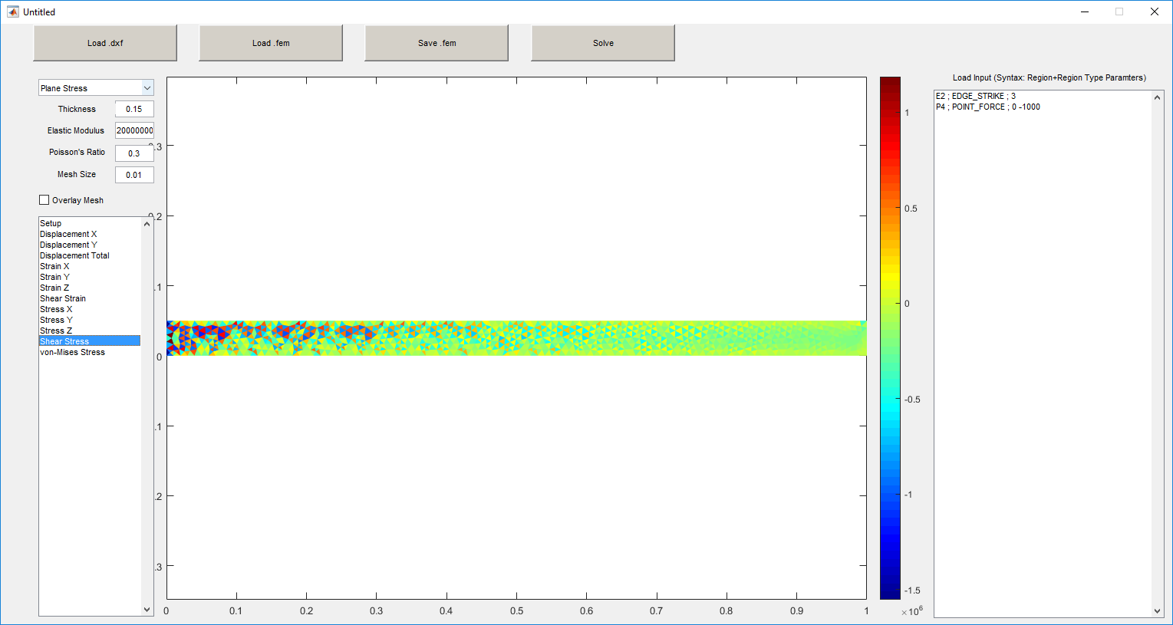

Slide 10
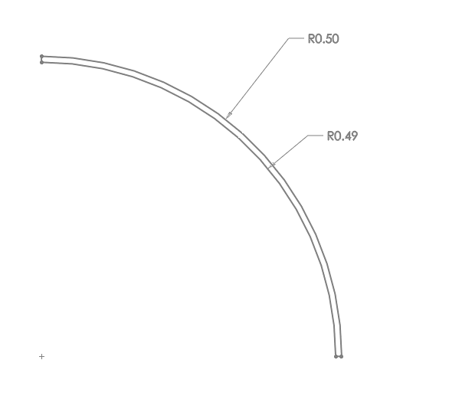
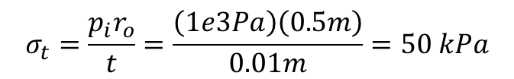
Patch test 3, thin-walled pressure vessel
Thin-walled assumption, hoop stress
1000 Pa
$$σ_{t}=\frac{p_{i}r_{o}}{t}=\frac{\left(1e3Pa\right)\left(0.5m\right)}{0.01m}=50 kPa$$
Analytic solution taken from: Norton Machine Design: An Integrated Approach (3rd Edition)

Slide 11
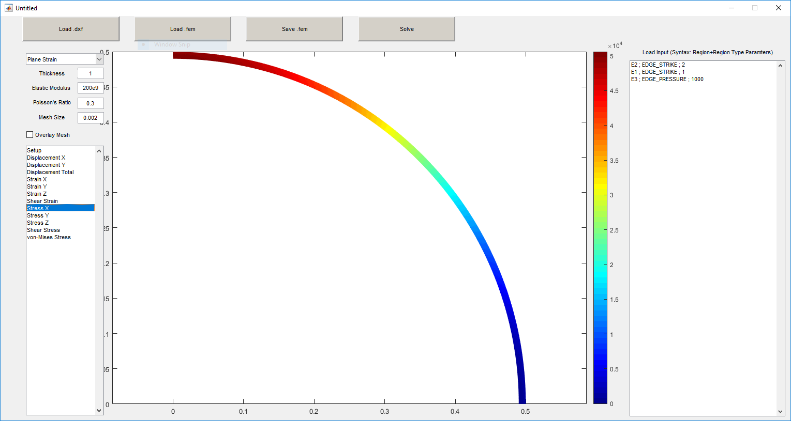
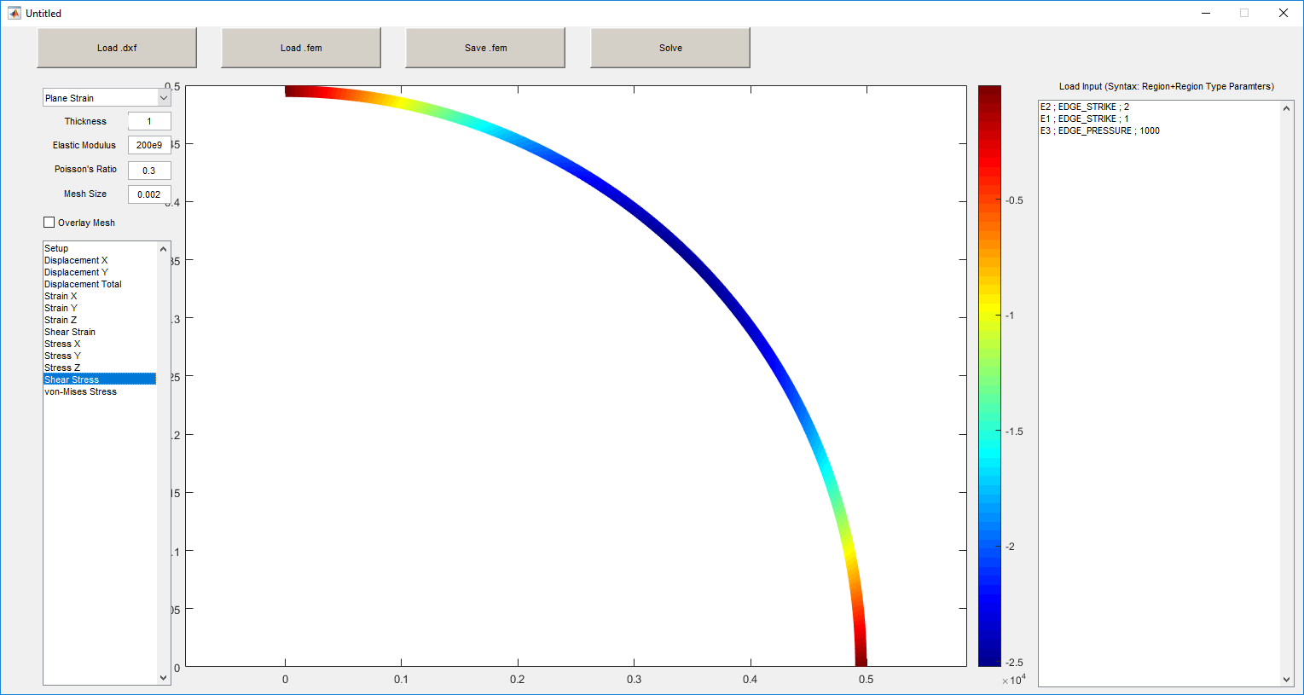
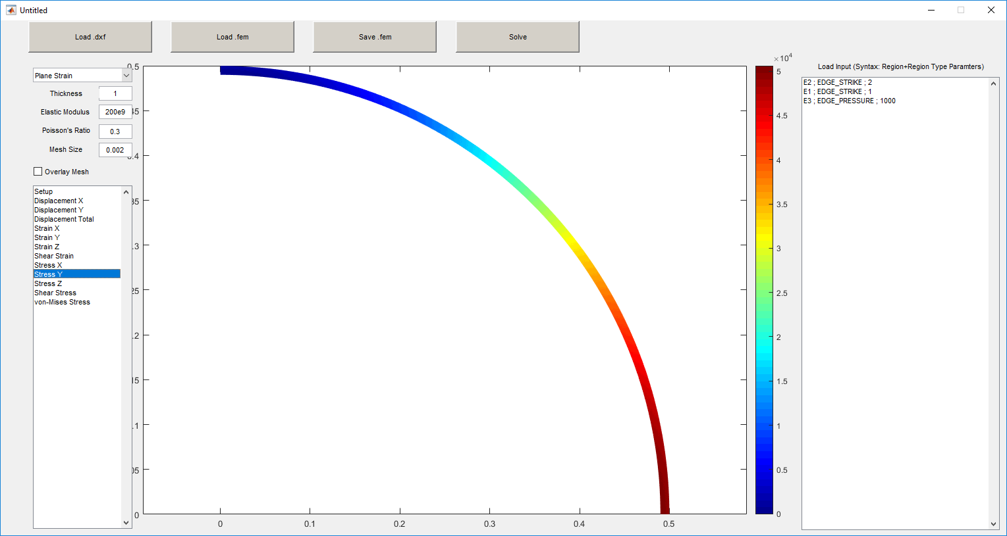
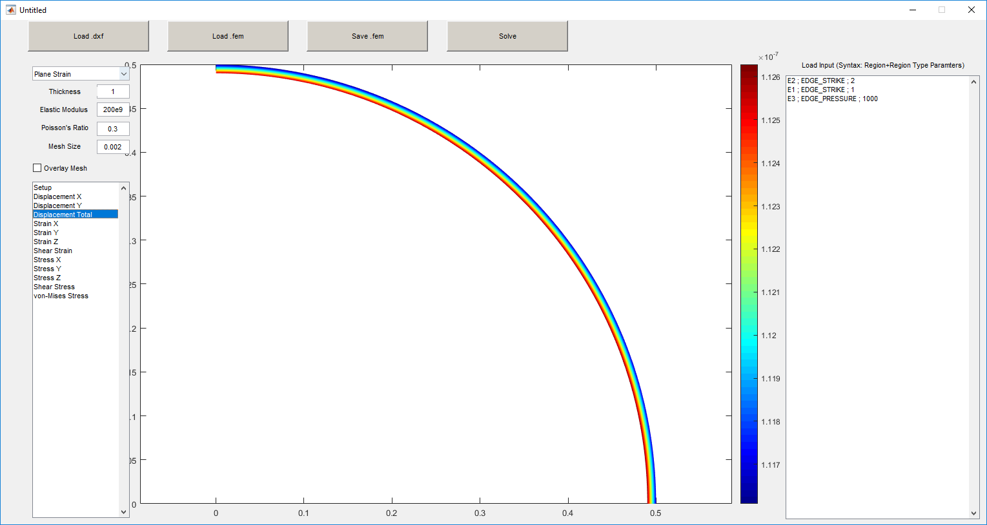

Slide 12
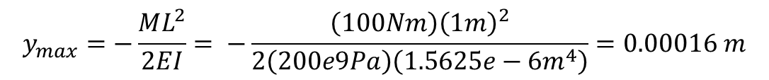
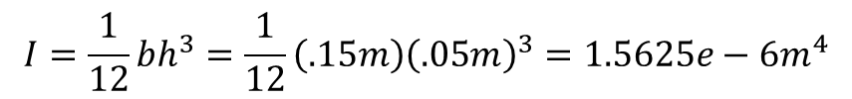
Patch test 4, cantilever beam, applied moment
Euler-Bernoulli Beam Theory
$$I=\frac{1}{12}bh^{3}=\frac{1}{12}\left(.15m\right){\left(.05m\right)}^{3}=1.5625e−6m^{4}$$
$$y_{max}=−\frac{ML^{2}}{2EI}= −\frac{\left(100Nm\right){\left(1m\right)}^{2}}{2\left(200e9Pa\right)\left(1.5625e−6m^{4}\right)}=0.00016 m$$
100 Nm

Slide 13
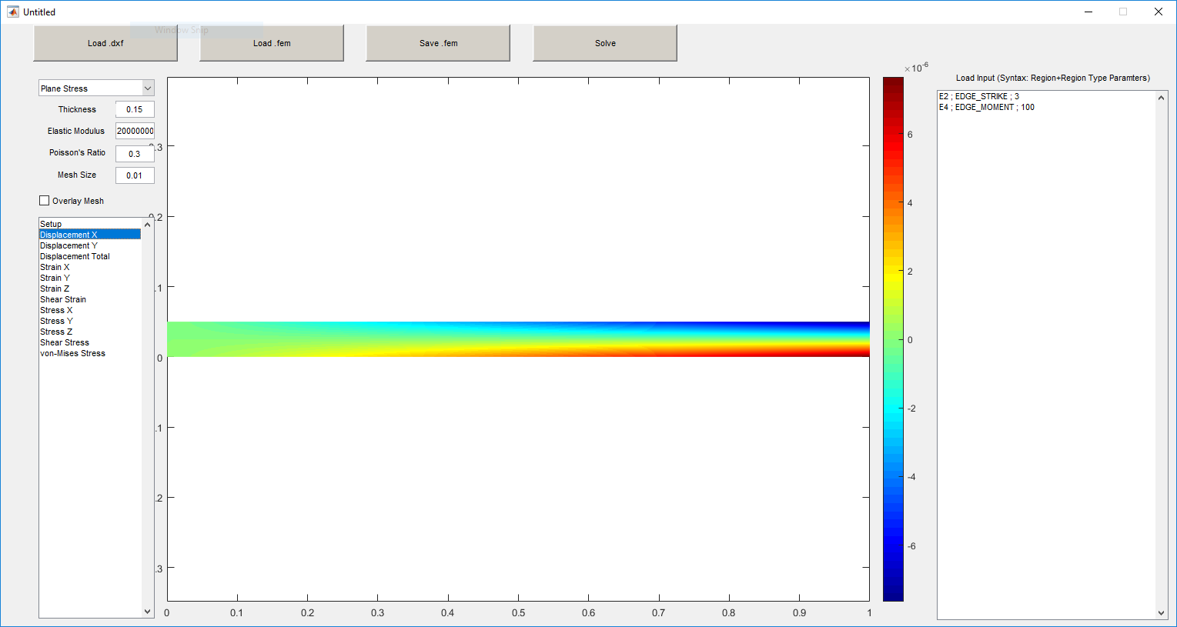
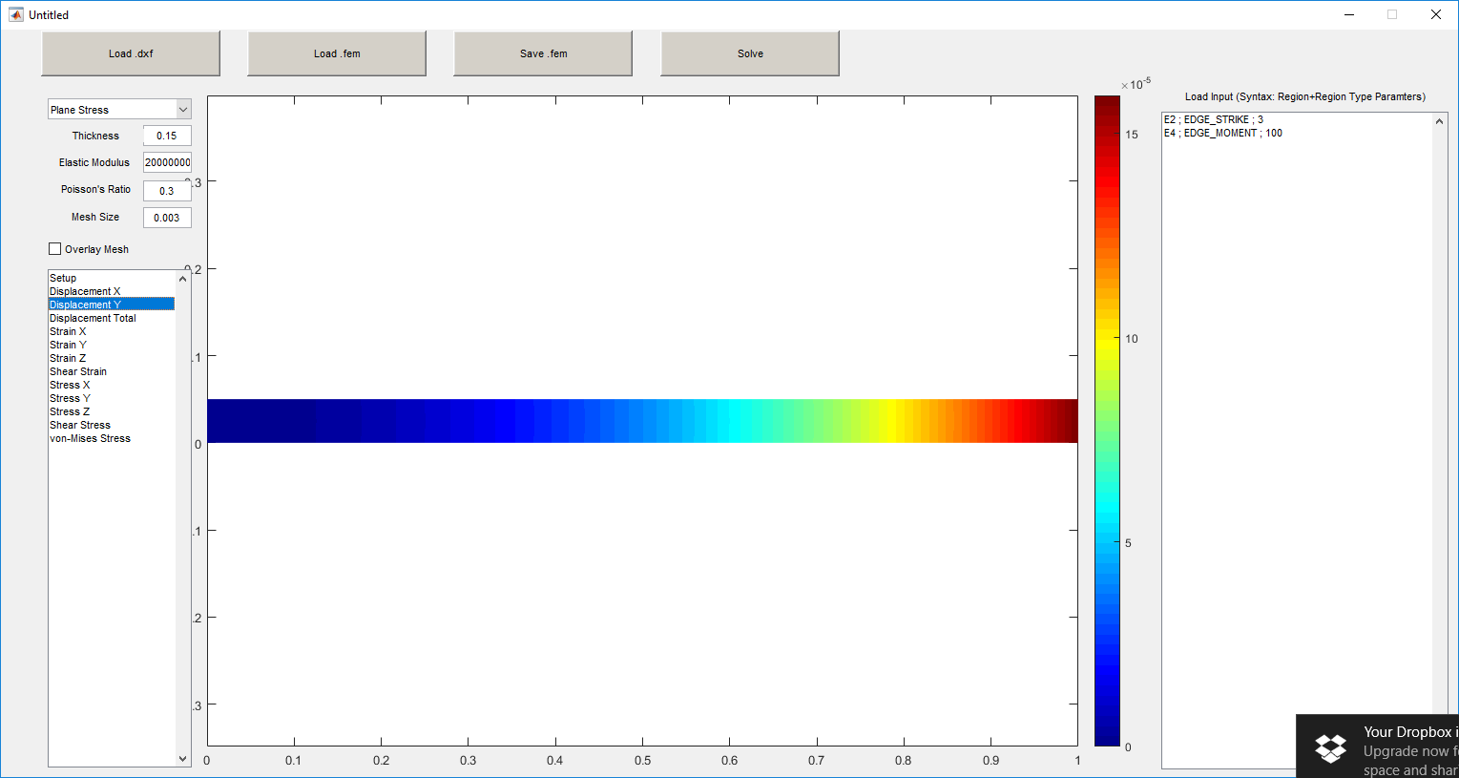
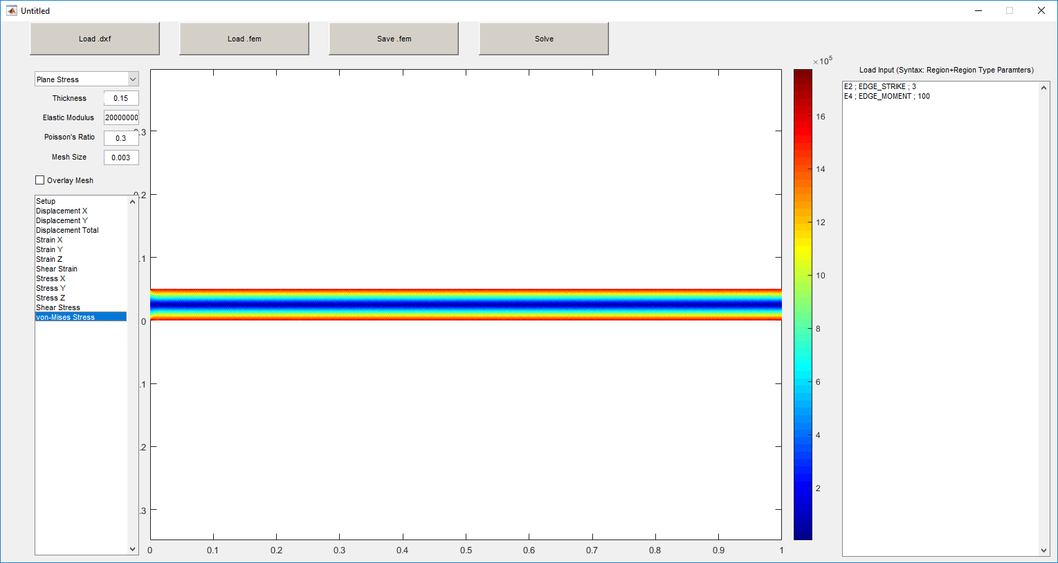
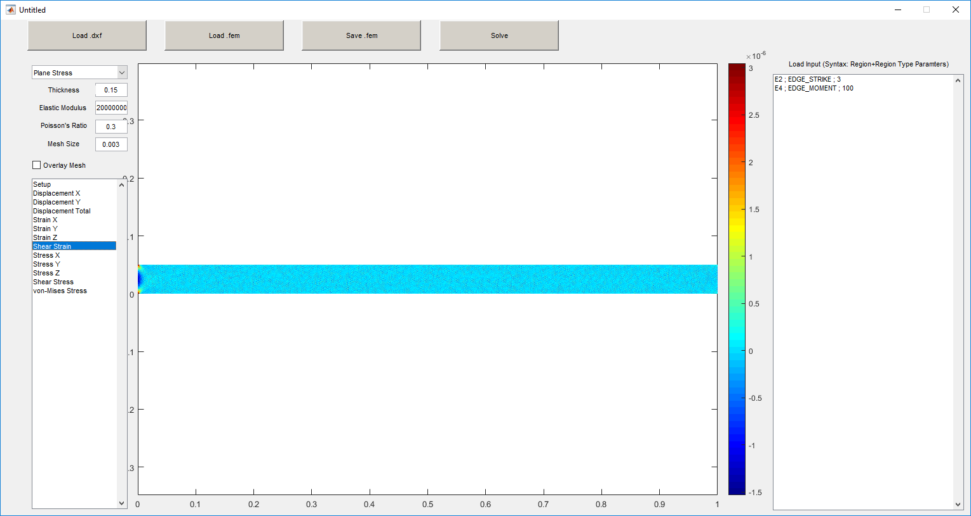

Slide 14
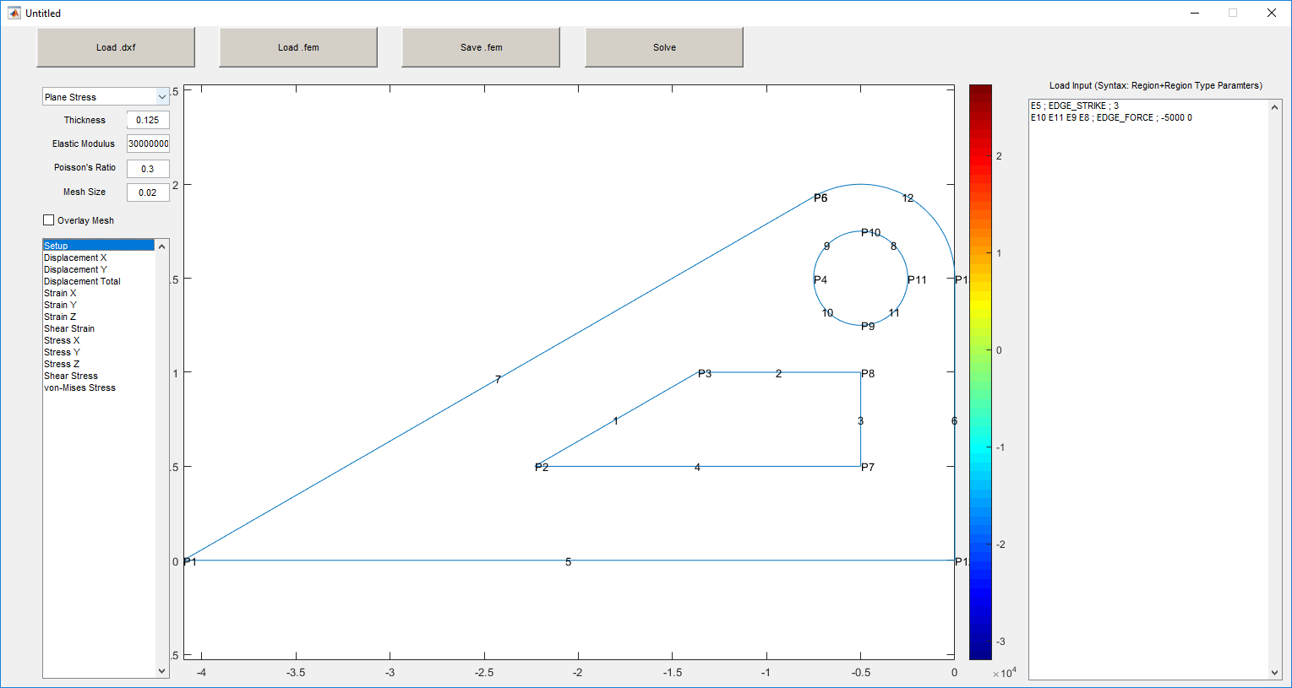
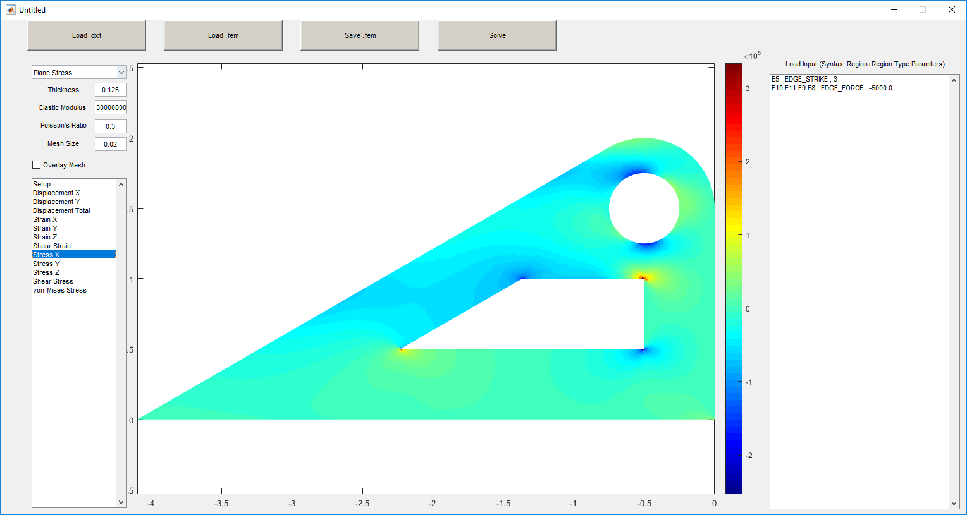
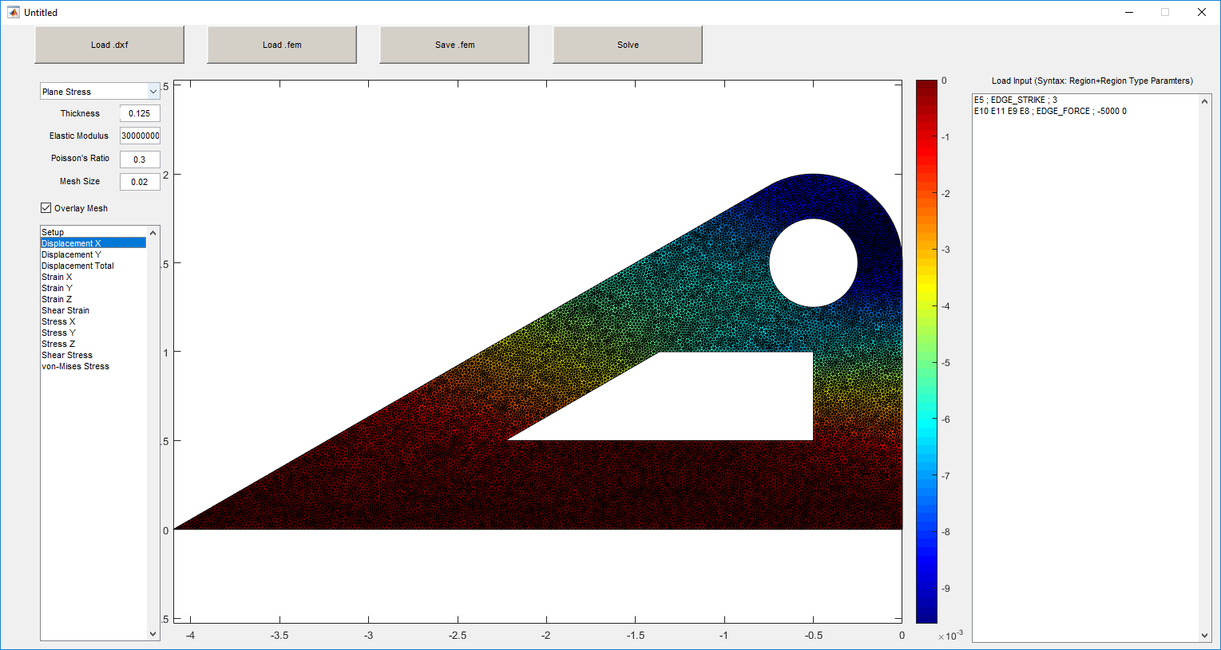
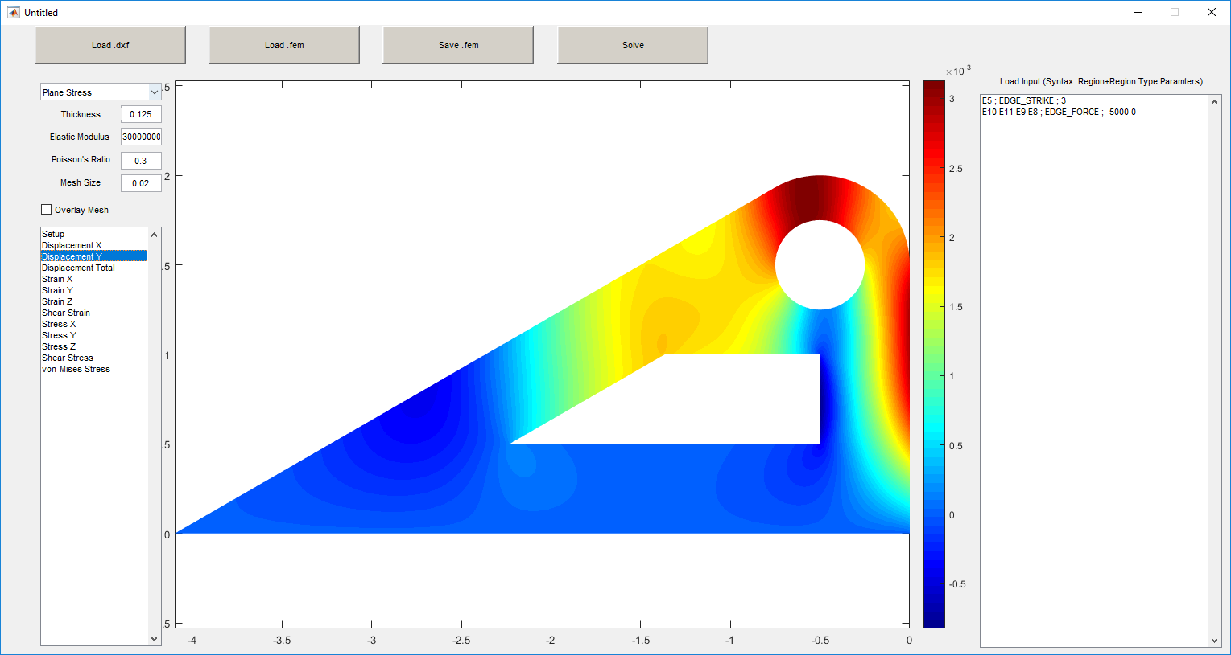
Pretty pictures - bracket

Slide 15
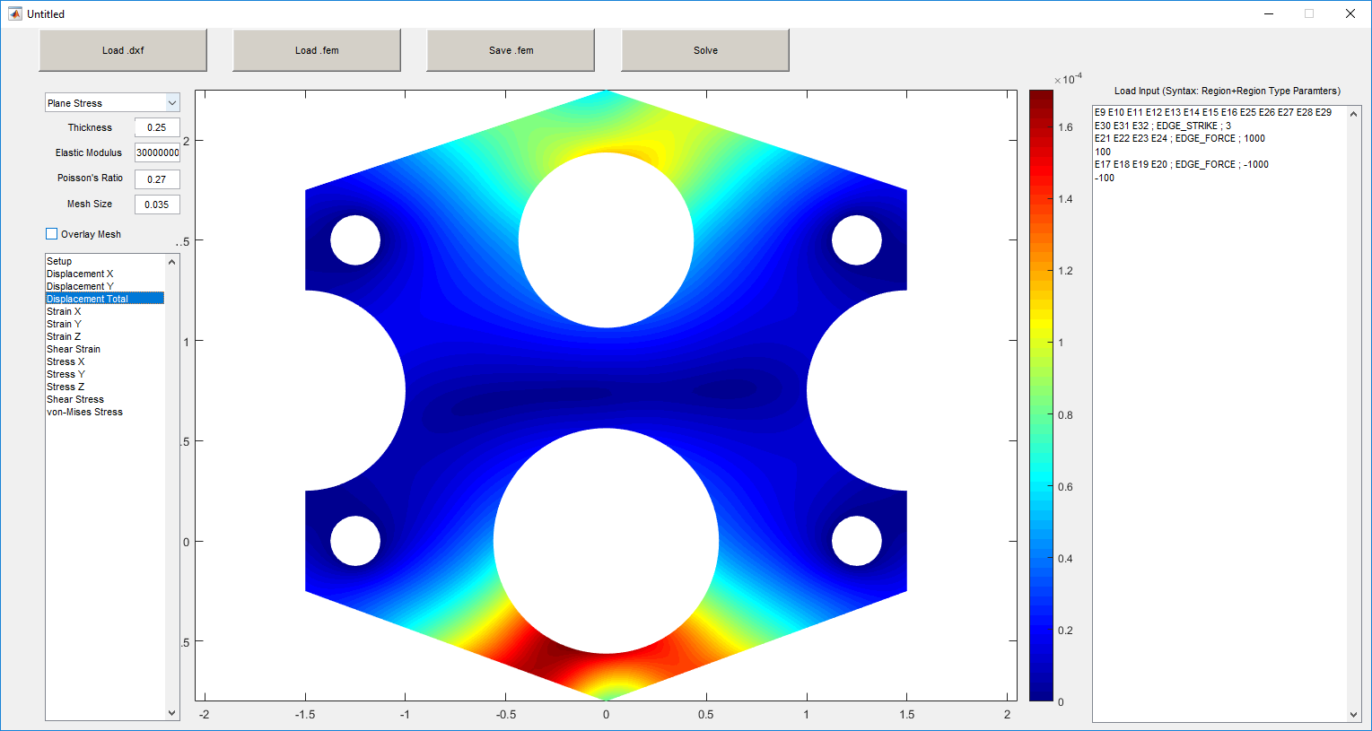
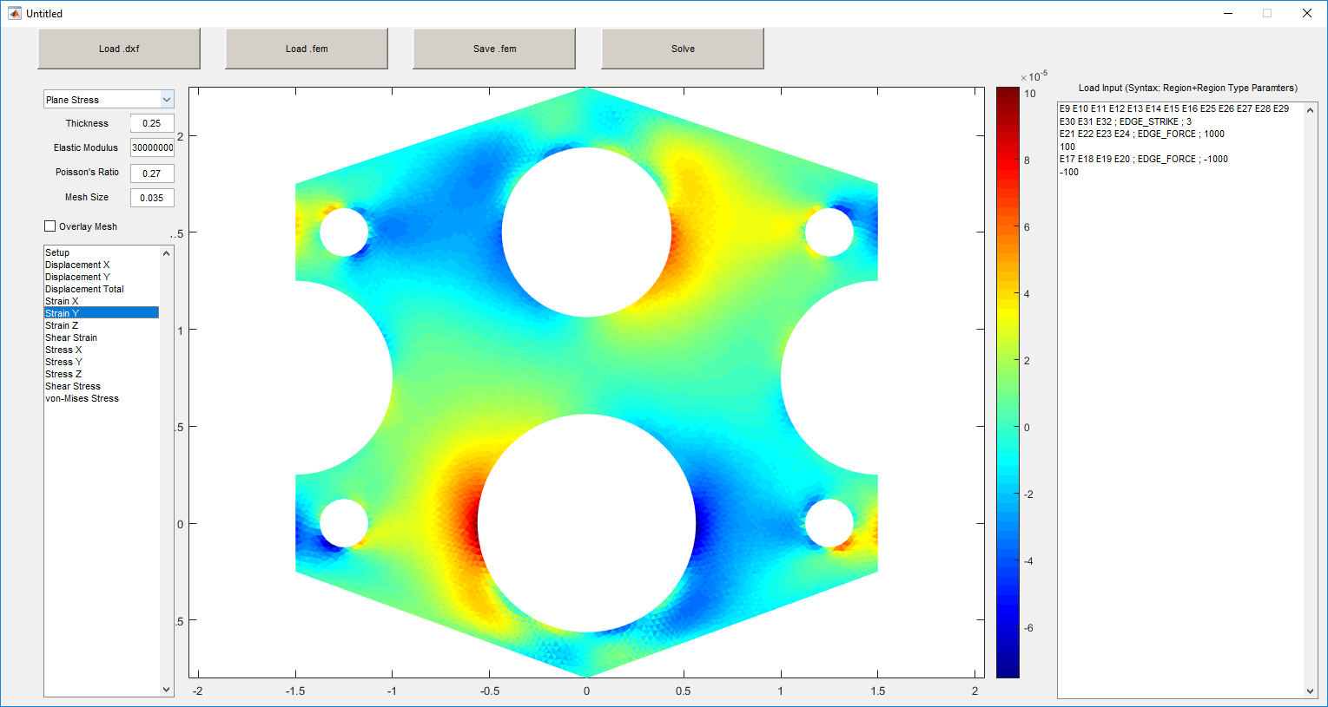
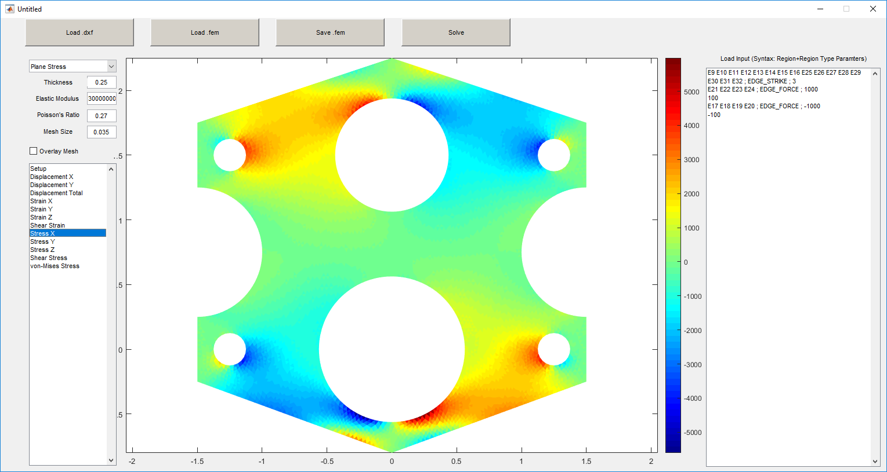
Pretty pictures - gearbox

